Slide 1

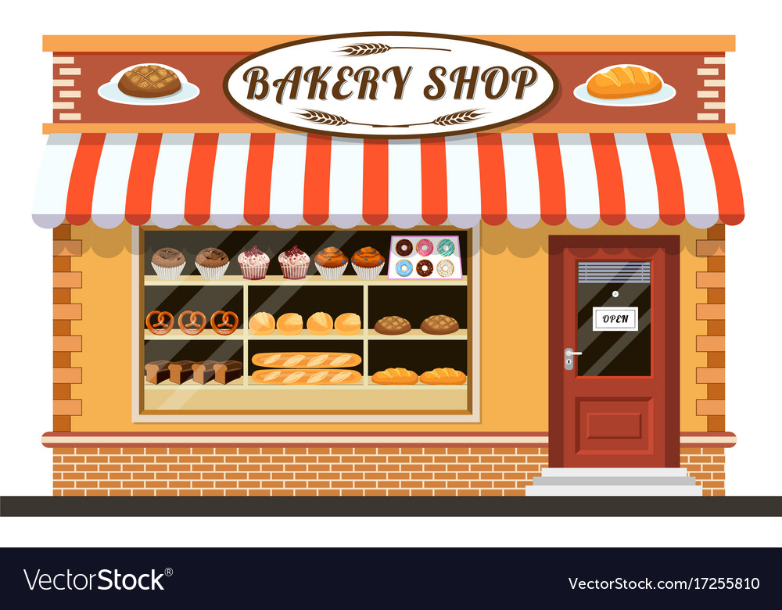
ONLINE BAKERY SHOP SYSTEM
Final Presentation
Bakery Shop
Group members:
Vanessa 2320120895
Iris 2320125471
Lucy 2320539669
Chris 23211210245

Slide 2
CONTENTS
INTRODUCTION
RESPONSIBILITY OF THE TEAM MEMBERS
COMPANY BACKGROUND
Introduction of company
Introduction of client company
PROJECT SCOPES
Vision statement
Stakeholders
Target user
PROJECT OBJECTIVES
PROBLEM STATEMENT
FEATURES / FUNCTIONS
VIII. PROPOSED SYSTEM
Context diagram
Level 0 diagram
Level 1 Diagram
Implementation constraints
IX. PROJECT BENEFITS AND COSTS
X. WORK BREAKDOWN STRUCTURE
XI. GANTT CHART
XII. COMMUNICATION PLAN WITH STAKEHOLDERS
XIII. APPENDIX: USER REQUIREMENT
XIV. E-R DIAGRAM
GUI OF THE PROPOSED SYSTEM
Bakery Shop

Slide 3
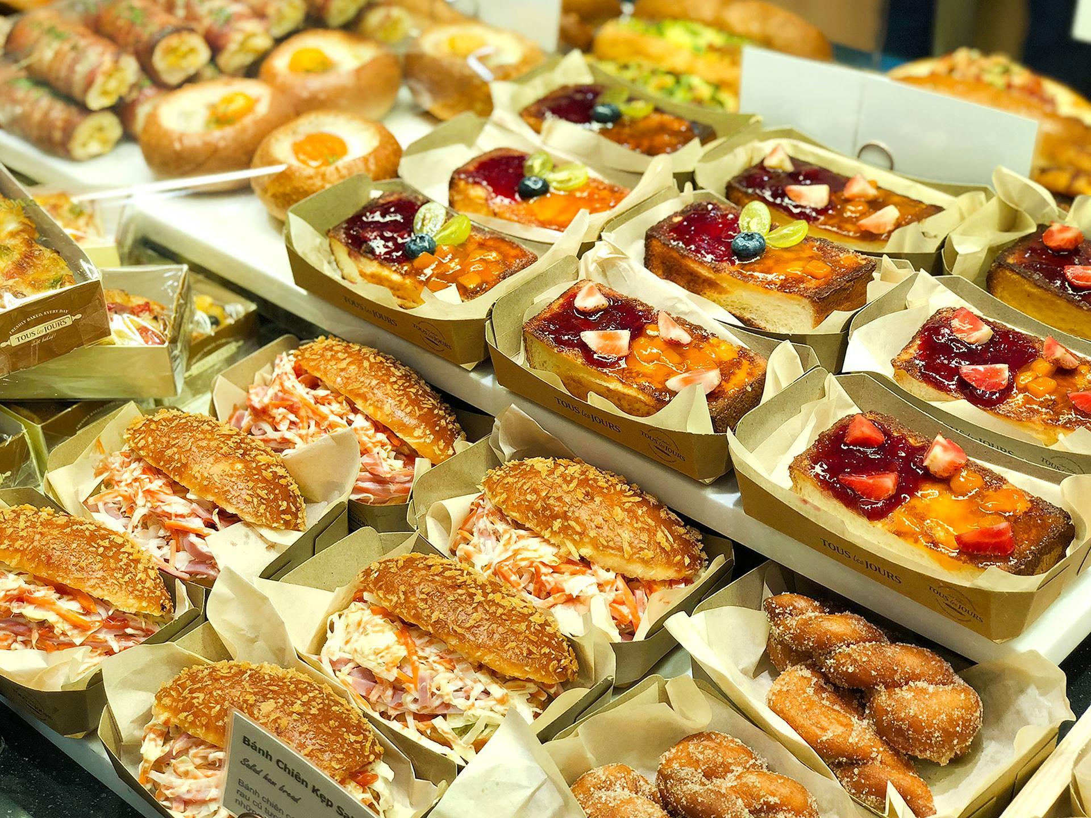
INTRODUCTION
In the present time, as technology develops, online website is increasingly developed in the world as well as Vietnam and gradually asserts its position in the market economy. Programming languages allow for the design and construction of the sales system in various forms. And one of the popular online website in our country is the online ordering website. This service allows users to search and select bakery products to buy, make transactions without having to go directly to the store, but only using a computer device, an Internet-connected phone, and provides users and managers with the necessary functions to buy, sell, and manage store operations by simple manipulation.
Bakery Shop

Slide 4
II. RESPONSIBILITY OF THE TEAM MEMBER
Team member roles
Name | Role | Task
Iris + Vanessa | Business Analyst System Analyst | Collecting user requirements Eliciting requirement Analyzing requirement Making the Proposal project, URD (ConOps), SRS
Lucy | Front-end Engineer | Designing Website with PSD in photoshop Converting the PSD to HTML, CSS, Bootstrap, etc. Combine the .html, .css file to .php file
Iris + Vanessa | Design Database | Designing database in visual paradigm tool Researching mySql, PostgreSQL Creating table in databases Checking all tables and fields after migration in the server Maintain and update/ reset database when having error or unsuitable things
Bakery Shop
Notes:
URD: User Requirements Document
SRS: software requirements specification
ConOps: Concept of operations

Slide 5
II. RESPONSIBILITY OF THE TEAM MEMBER (cont.)
Team member roles
Name | Role | Task
Chris | Back-end Engineer | Viewing the SRS document Research new function in system Coding all of features function release in version 1,2,3,4,etc. Maintain and update when having errors
Vanessa | Project Manager | Viewing the SRS document Monitor the individual activity Assign task for members Review code , task Find the customer's demand Explain with team member Use tool to manage the member in team Finishing project on time
Lucy | Tester | Testing code in each version
Bakery Shop
Notes:
URD: User Requirements Document
SRS: software requirements specification

Slide 6
III. COMPANY BACKGROUND
Introduction of company
RunSystem tech is a company of and by software engineering professionals. We have been providing outstanding quality for software engineering and software testing services since 2018.
With a pool of experienced IT engineers in developing, designing, we reliably offer clients the value-added solutions, professional skills, accountability, and industrial domain knowledge to reduce operating costs, eliminate risks, deliver solutions on time and on the budget as well as ensure the right decision has been made as our best solutions and services.
Our Expertise - Web development - App development - Cloud computing
Our programing language: PHP, ReactJS, JAVA, NodeJS, ...
Database: MySQL, PostgreSQL,...
Bakery Shop

Slide 7
III. COMPANY BACKGROUND (cont.)
Introduction of company
RunSystem Tech is located at 137 Nguyen Van Linh, Danang, Vietnam
Contacts
- Office: +84 (236) 625 3767
- Fax: +84 (236) 625 3289
- Vietnam Mobile: +84 (945) 15 19192
- USA Mobile: +1 (559) 391-0657
- Skype: runsystemtech.xo
- Website: www.runsystemtech.com
Bakery Shop

Slide 8
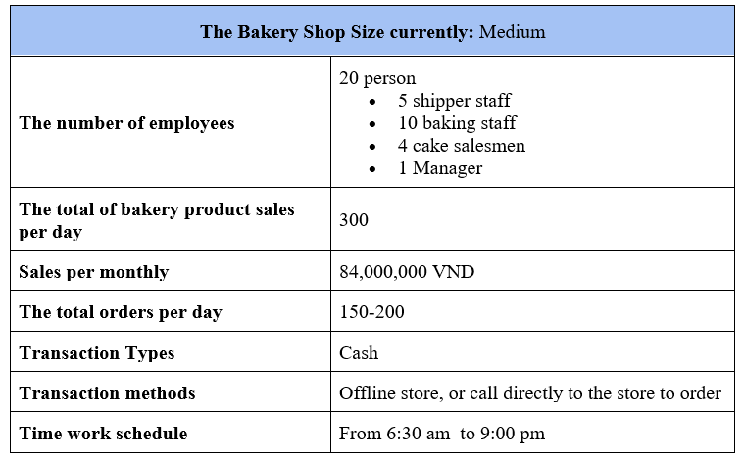
III. COMPANY BACKGROUND (cont.)
2) Introduction of client company
Bakery Shop
Bakery Shop
Notes:
In the current time, the bakery shop is located in 254 Nguyen Van Linh st, Danang. It
has a medium size. The number of employees is 20 people in total it includes 10
baking staff, 4 cake salesmen, 1 manager, 5 shippers. The total of the bakery product
is sold at 300 per day. The number of sales is about 84,000,000 per monthly. The
average is from 150-200 orders per day. The current methods of sales bakery products
is an offline store, it means the customer must go to directly store to buy bakery
products, or call directly to the store to order bakery products. The time schedule
works of the employees from 6: 30 am to 9:00 pm.

Slide 9
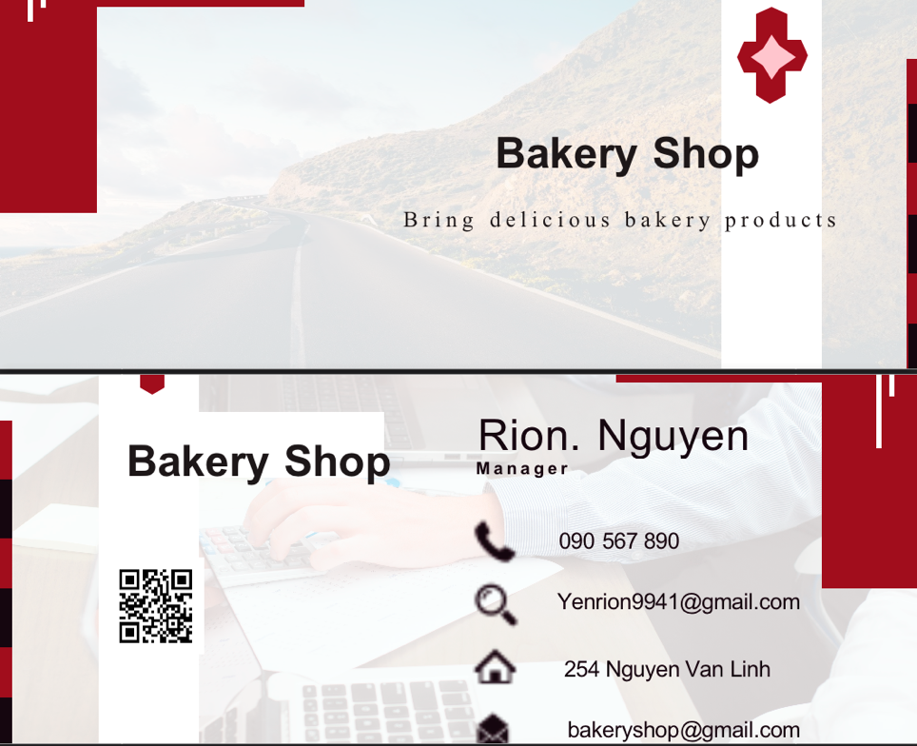
III. COMPANY BACKGROUND (cont.)
Bakery Shop

Slide 10
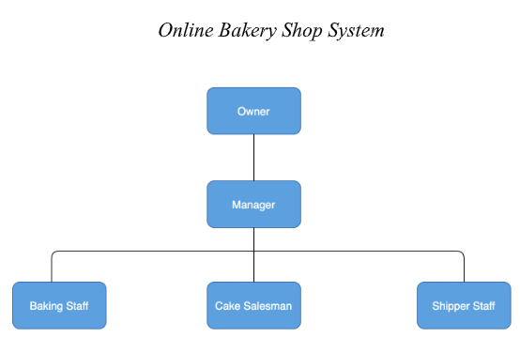
III. COMPANY BACKGROUND (cont.)
Bakery Shop

Slide 11
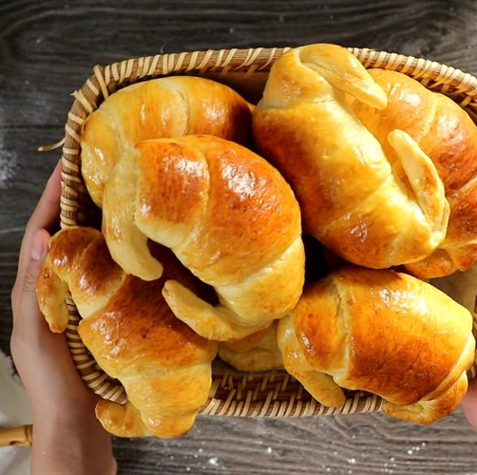
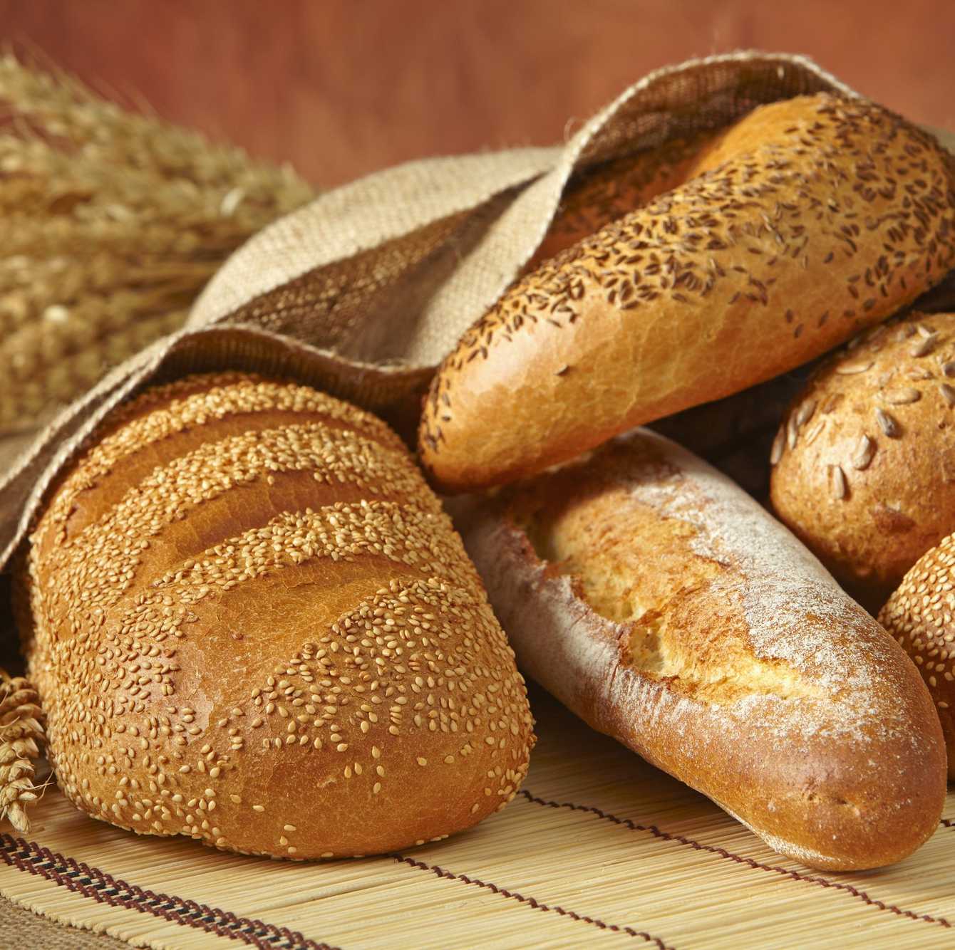
iv. PROJECT SCOPES
Vision statement
Stakeholders
Target user
Bakery Shop

Slide 12
1) VISION STATEMENT
FOR | The bakery's owners
WHO | Want to have a system to support buy bakery online
THE | System
IS A | Website
THAT | Helps customers find the bakery products, add to cart, make a payment, and helps owners, managers manage staff, and view statistics such as sales, costs, profits exactly
UNLIKE | The traditional way, it needs many staff to serve and take a lot of money. Sometimes there are some errors in payments, orders, statistics. This makes the owners hard to manage and the customer is not satisfied with services
OUR PRODUCT | - Helps customers view the menu, communicate, orders by simple manipulation - Support owners, managers easily to organize the shop, view the detailed statistics exactly
Bakery Shop

Slide 13
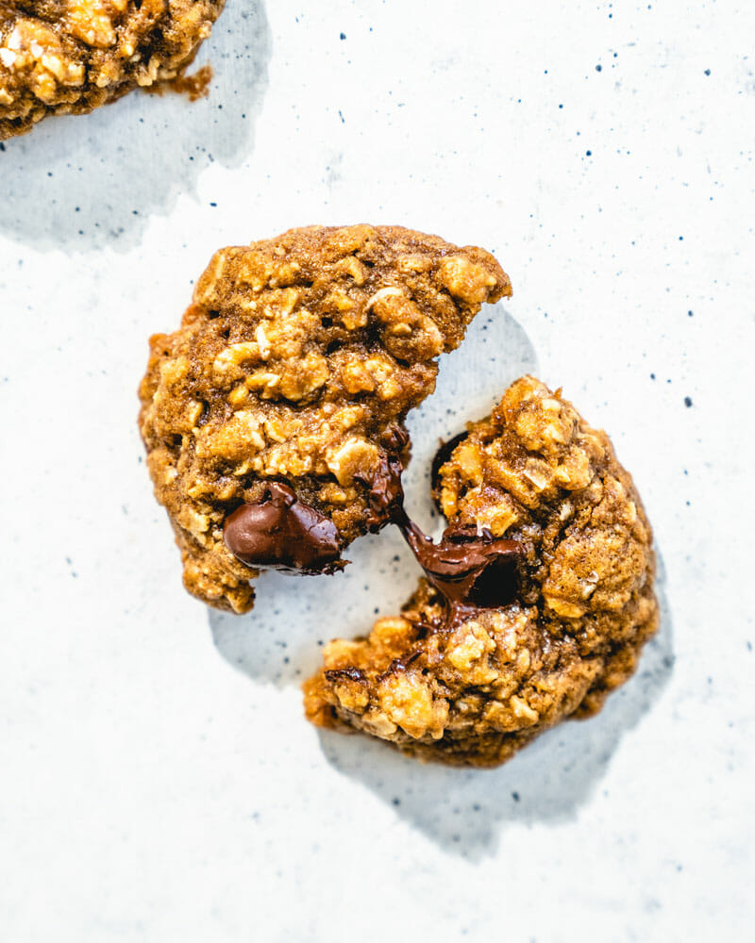
2) STAKEHOLDERS
User: Customer, staff, manager
Owner
Business Analyst
Developer
System analyst
Tester
Project Manager
Designer
Bakery Shop

Slide 14
3) TARGET USER
Customers can view the information on the type of bakery products in the system. They can register to become a member of the bakery system, and totally able to log in and edit their personal information. Before making the payments online, they can add bakery products in cart, order, and check out the order online about the bakery product, location, total payment, choose a method to pay (Cash or Credit). Customers can send feedback after enjoy eating bakery products. They can log out in order to secure their account.
Staff can edit, add, and remove bakery products information in the system. They can manage their personal information account. They can view, handle the order, and assign tasks for other staff.
The manager can edit, add, and remove members in the system and view statistics about sales, profit, orders, customers.
Bakery Shop

Slide 15
V. PROJECT OBJECTIVES
Providing an efficient interface for the online management bakery system.
Give customer opportunity finding, viewing, and buying all bakery products without thinking distance or time so it makes the customer feel convenient as well as comfortable when using our website.
Show a new recipe, e-menu, total payment, and produces transactions easily.
Reversing bakery products, recommend bakery products, insensitive report are common functions which also able on our website
Help reduce the quantity of work of staff in the offline store, handle large orders at once, help manage store by viewing statistic of sales, customers and amount of the orders, and manage the schedule of staff and their personal information
Bakery Shop
Notes:
The project aims at providing an efficient interface for the online management
bakery system. The basic idea involved here is that give customer opportunity
finding, viewing, and buying all bakery products without thinking distance or time
so it makes the customer feel convenient as well as comfortable when using our
website. It also shows a new recipe, e-menu, total payment, and produces
transactions easily. Reversing bakery products, recommend bakery products,
insensitive report are common functions which also able on our website. Besides,
the online bakery system help reduce the quantity of work of staff in the offline
store, handle large orders at once, help manage store by viewing statistic of sales,
customers and amount of the orders, and manage the schedule of staff and their
personal information.

Slide 16
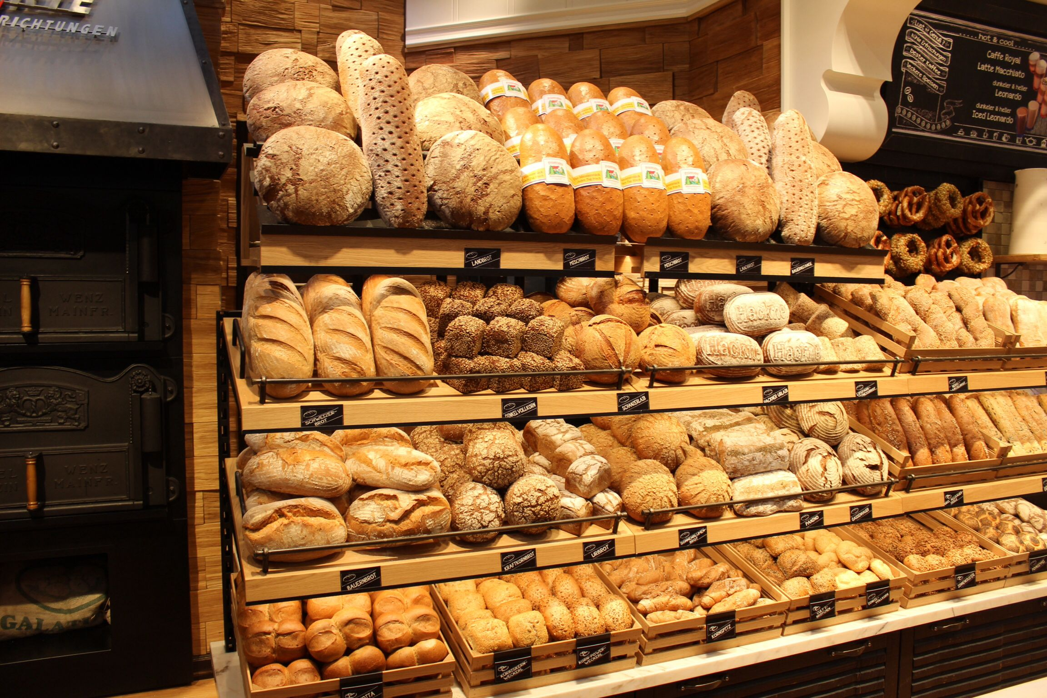
VI. PROBLEM STATEMENT
16
Problem 1: The large of customers increases day per day, so it faces the problem with orders and payment methods. This causes the unsatisfied problem of customers because of waiting for the calculation by the paper of the staff so long to buy bakery products.
Problem 2: Because the number of potential customers increases too many and the order could be more than 300 per day, the owner of the bakery store wants to broaden the size of the bakery shop is large to increase the sales for the bakery products
Problem 3: According to their survey about their customers, most of their customers want to online order and have multi-payment methods such as cash, credit card,...
Problem 4: Although the bakery shop is not large, sometimes hard to organize the store such as manage the staff in store, the total of customers, orders, or view the statistics of the store about sales... Because the traditional methods are written in the paper
Problem 5: Customers are also not satisfied with the store's services such as bakery products search, ordering, and payment. Because of a lot of bakery products, so they spend a lot of time finding bakery products that they prefer.
Bakery Shop

Slide 17
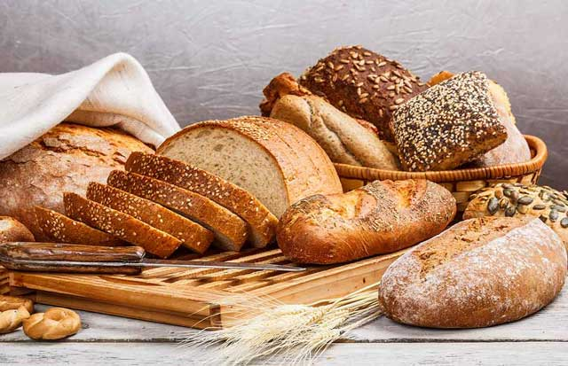
VII. FEATURE / FUNCTIONS
Account
Bakery products
Orders
Statistics
Members in a system
Bakery Shop
Bakery Shop
Notes:
Account
 Customer can register an account to become a member of the online
bakery shop system, log in and log out his/her account, update his/her
personal information in the account
Bakery products
 Staff can view the list of bakery products, add, update or delete bakery
products information in the system if the bakery products in online
store need to change such as having new bakery products; out of stock
or update price information of bakery products
Orders
 If the customer likes bakery products, he/she may add it to his/her cart.
He/she also can view, edit and delete the bakery products in cart
 Customer can check his/her order to confirm or cancel orders, payment
and view order status
 Staff view the list of orders to approve or cancel it
Statistics
 Manager can view statistic of sales, profits, orders, customers and a
member in the system
Members in the system
 Manager can view the list of members in the system, and add, update
and delete member in the system

Slide 18
VIII. Proposed System
Context diagram
Level 0 diagram
Level 1 Diagram
Implementation constraints
Bakery Shop

Slide 19
1. Context Diagram
Bakery Shop

Slide 20
2. Level 0 diagram
Bakery Shop

Slide 21
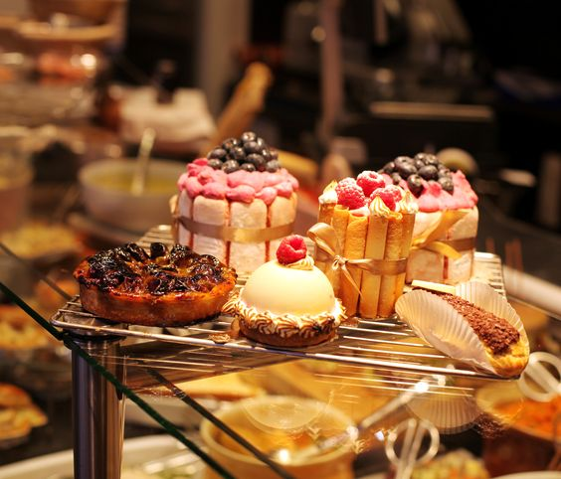
3. Level 1 diagram
Account
Bakery products
Orders
Manage staff
Statistics
Bakery Shop

Slide 22
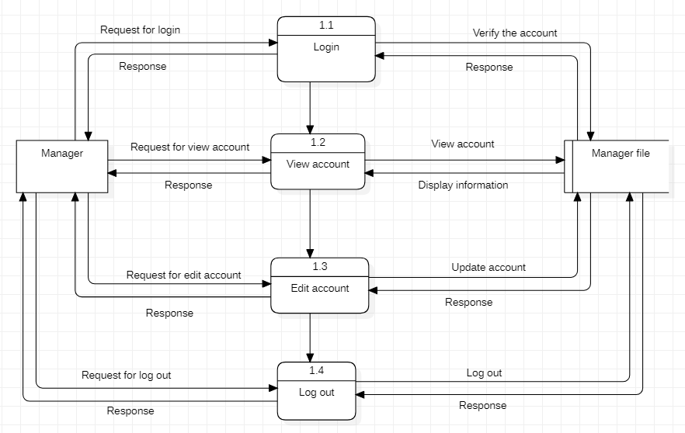
a) Account
Bakery Shop

Slide 23
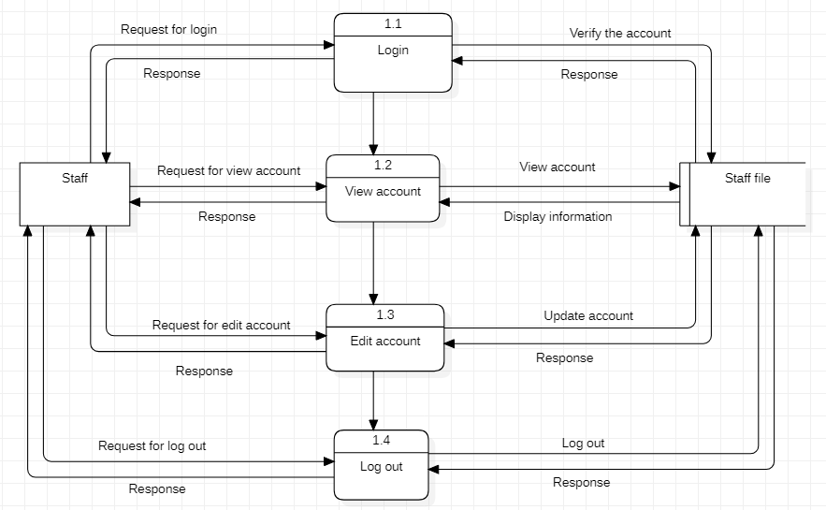
a) Account
Bakery Shop

Slide 24
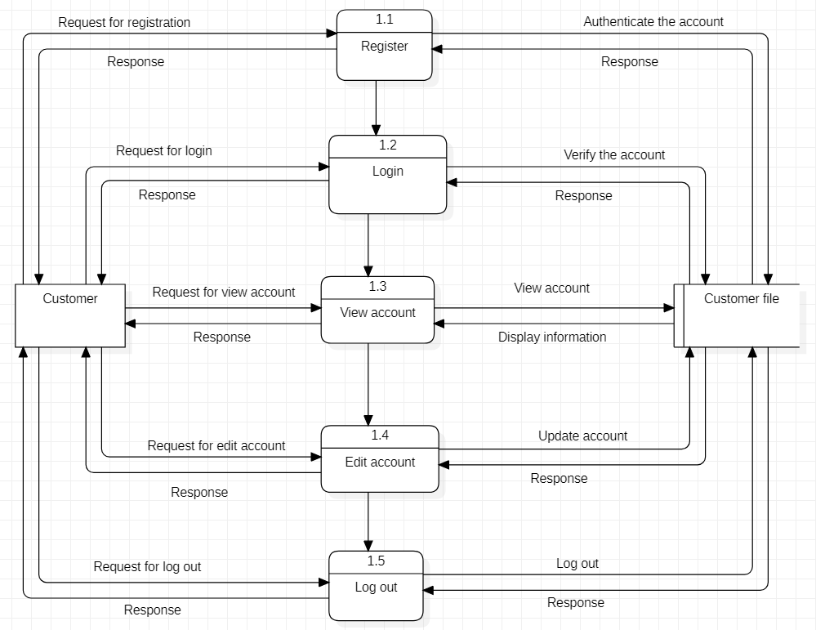
a) Account
Bakery Shop

Slide 25
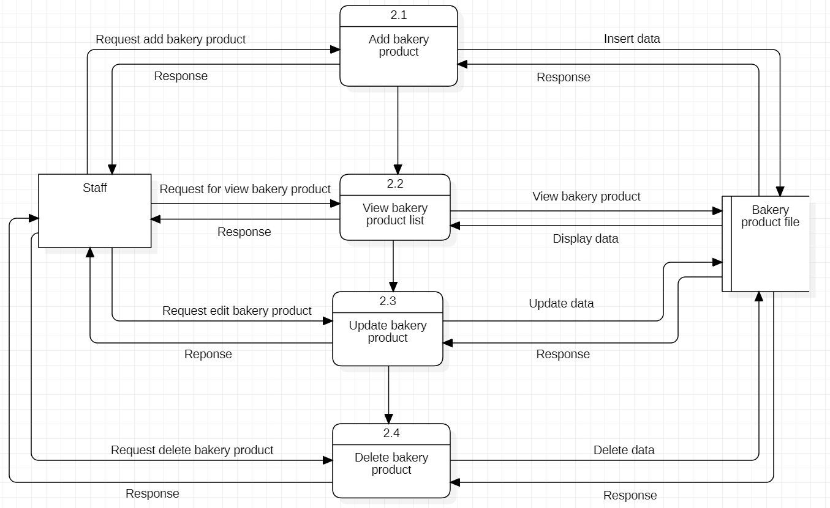
b) Bakery products
Bakery Shop

Slide 26
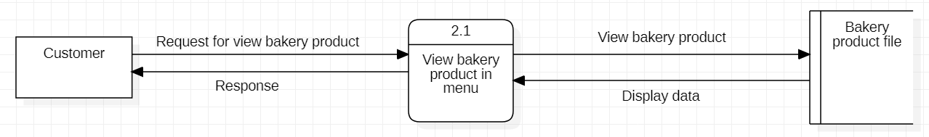
b) Bakery products
Bakery Shop

Slide 27
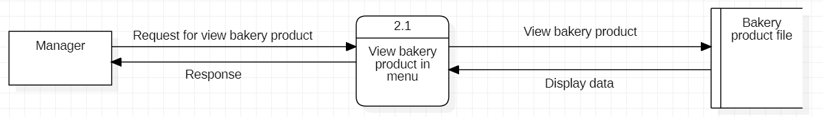
b) Bakery products
Bakery Shop

Slide 28
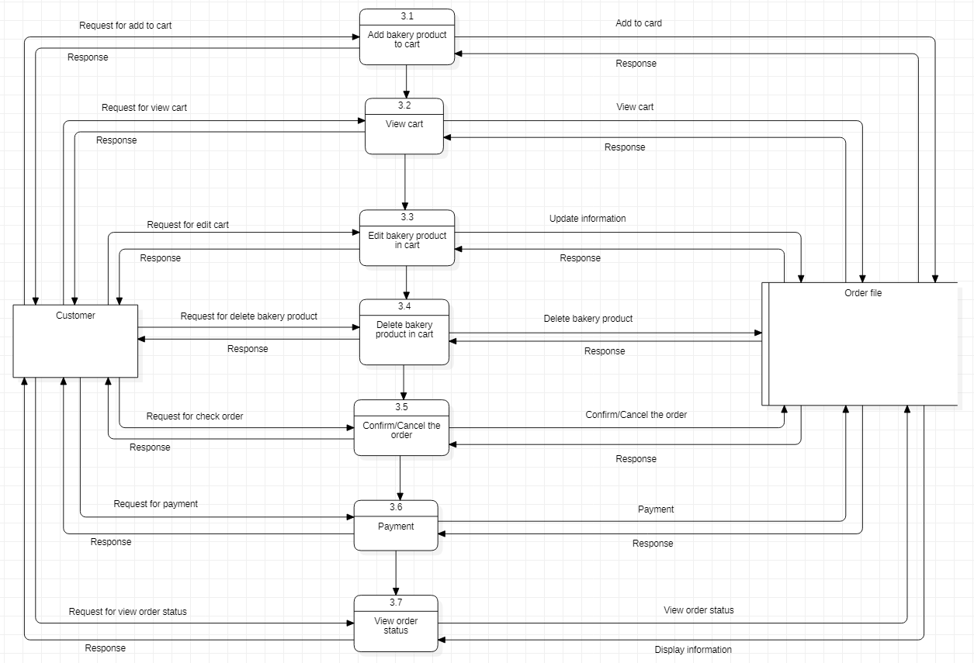
c) Orders
Bakery Shop

Slide 29
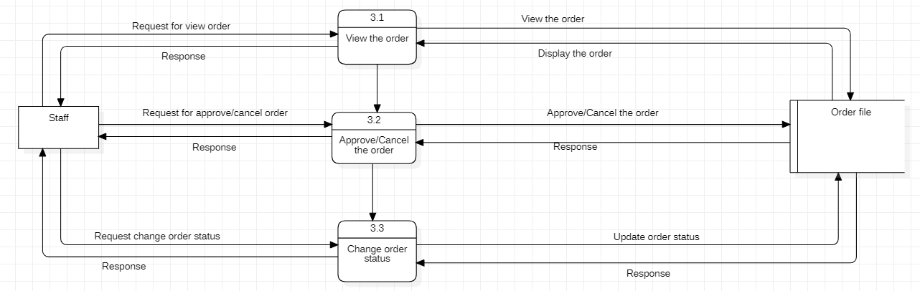
c) Orders
Bakery Shop

Slide 30
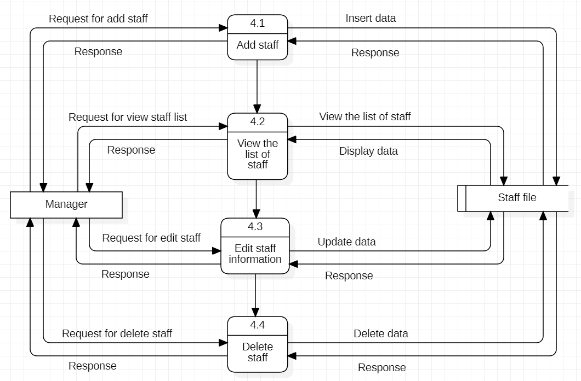
d) Manage staff
Bakery Shop

Slide 31
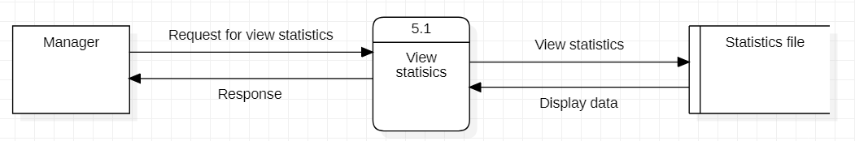
e) Statistics
Bakery Shop

Slide 32
4. Implementation constraints
Hardware
Server side:
Operating system: Windows 7 or above
Processor: 2Ghz or faster
Hard disk: 1 TB
RAM: 8 GB or above
Database capacity: 8GB
Client Side:
Operating system: Windows 7 or above
Processor: 2Ghz or faster
RAM: 8 GB or above
Bakery Shop

Slide 33
4. Implementation constraints(Cont.)
Software
Operation system: Windows 7 or above
Language: PHP, ReactJs
Database management: PostgreSQL, Mysql
For website: Buy domain, update server
Run in all of devices
Bakery Shop

Slide 34

IX. Project benefits and costs
Project benefits
Costs
Bakery Shop

Slide 35
1) Project benefits
Tangible benefits
 | Year 1 through 5
Cost reduction and avoidance | 40,000,000 vnd
B. Error reduction | 45,000,000 vnd
C. Increased flexibility | 75,000,000 vnd
D. Increased speed of activity | 100,000,000 vnd
E. Improvement of management planning and control | 60,000,000 vnd
F. Opening new markets and increasing sales opportunities | 90,000,000 vnd
Other | 10,000,000 vnd
Total tangible benefits | 420,000,000 vnd
Bakery Shop

Slide 36
1) Project benefits (cont.)
Intangible benefits
Improving the user experience that could be because the upgrade makes software or hardware easier to use, significantly faster or more secure against hacking.
Increased customer satisfaction and brand loyalty benefit the business.
Speeding up or automating IT operations may reduce staff's workloads.
Lowering the risk of a data breach.
Creating autonomy may involve allowing workers to telecommute or tinkering with work conditions at the shop.
Timely information and availablity of new, better, or more information
Improved work process and Faster decision making
Bakery Shop

Slide 37
2) Costs
One-Time Cost
 | Year 0
Development Cost | 20,000,000 vnd
B. New Hardware | 15,000,000 vnd
C. New Software | 20,000,000 vnd
D. User Training | 5,000,000 vnd
E. Site Preparation | 0
F. Other (Domain, Server, etc.) | 5,000,000 vnd
Total one-time costs | 65,000,000 vnd
Recurring Costs
 | Year 1 through 5
Application Software Maintenance | 5,000,000 vnd
B. Incremental Data Storage Required: 20GB | 10,000,000 vnd
C. Incremental Communication | 2,000,000 vnd
D. New Software and Hardware leases | 20,000,000 vnd
Supplies | 0
F. Other (Domain, Server, etc.) | 5,000,000 vnd
Total Recurring Costs | 42,000,000 vnd
Bakery Shop

Slide 38
Tangible Benefits | Intangible Benefits
Improved productivity and efficiencies Reduced costs Increased revenue Meeting changing demands of the marketplace Less waste (materials, time, resources) Reduced head count (in these more politically correct times, it's better to phrase this in more sensitive terms: “reallocation of existing staff to other company areas” or “eliminate the need to add to staff”) | Improving the user experience that could be because the upgrade makes software or hardware easier to use Increased customer satisfaction and brand loyalty benefit the business reduce staff's workloads Lowering the risk of a data breach Improved work process and Faster decision making Creating autonomy may involve allowing workers to telecommute or tinkering with work conditions at the shop.
Tangible Cost (One-Time) | Intangible Cost
Internet service setup fee Hardware Development Cost Data Entry | Reduction face-to face interaction Not all customers use Internet Decline employee morale Loss of intellectual capital following employee layoffs
Tangible Cost (Recurring)
Internet service hosting fee Software Support Maintenance Decreased sales via traditional channels
Bakery Shop

Slide 39
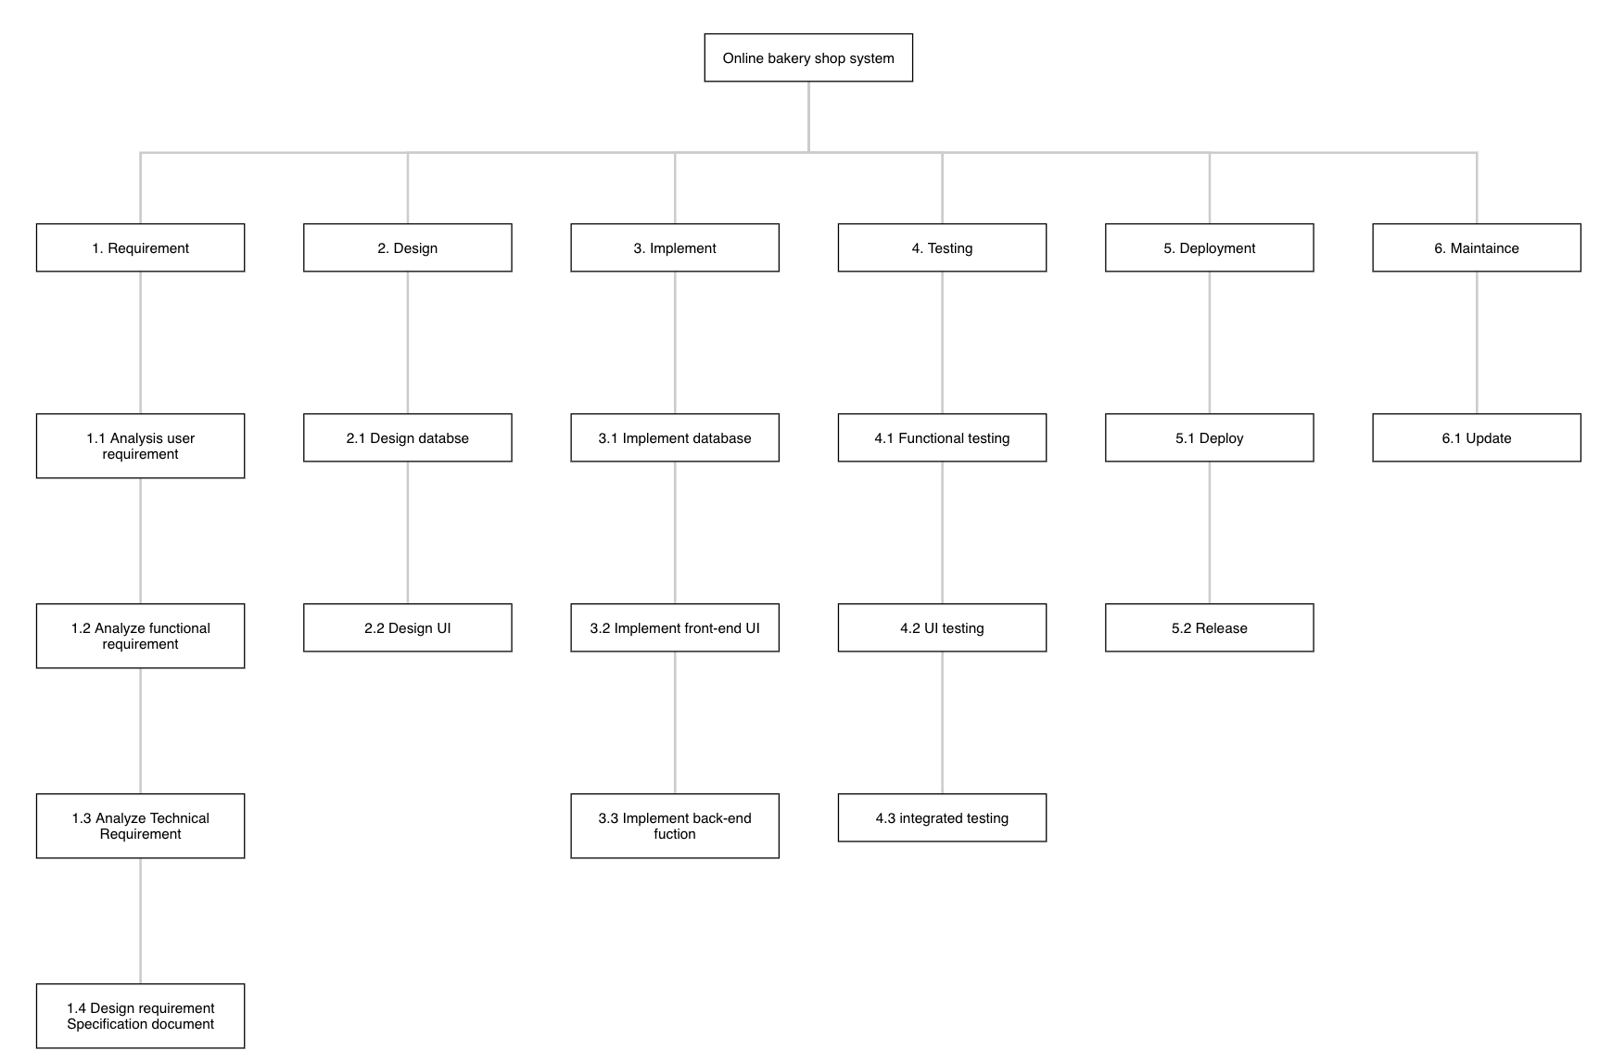
X. WORK BREAKDOWN STRUTURE IN WHOLE PROJECT (WBS)
Bakery Shop
https://planhammer.io/project/5ed7a21b6cabc6231dfce3f0/show/detailed

Slide 40
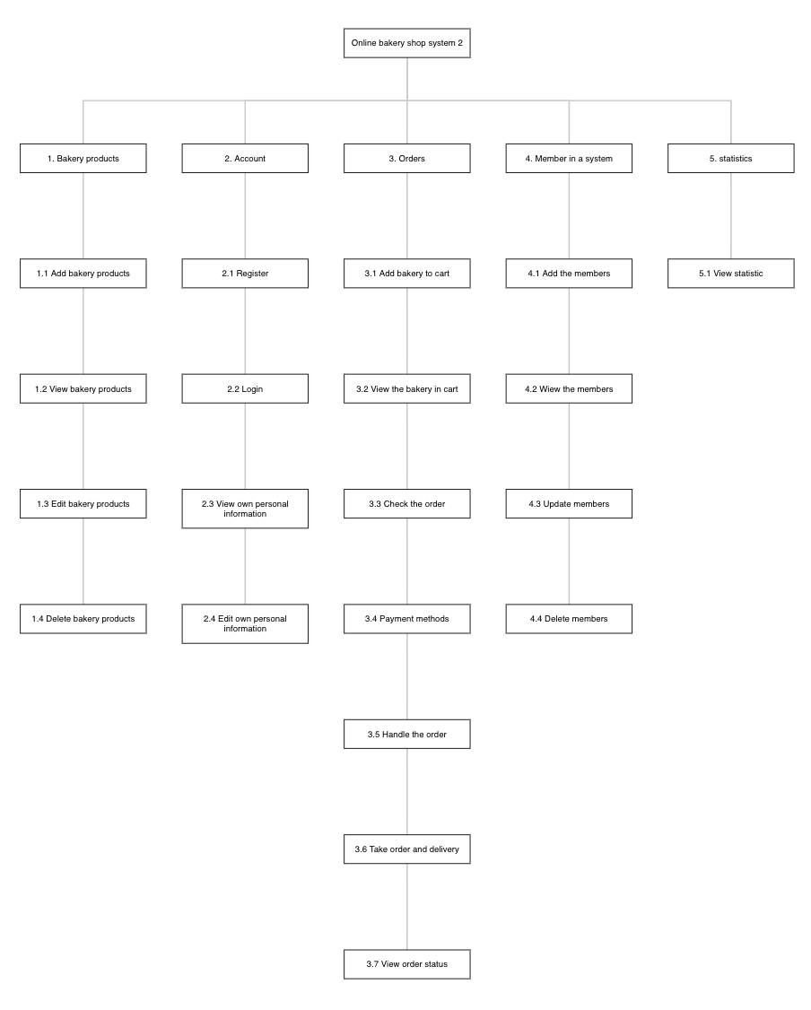
X. WORK BREAK DOWN FUNCTIONS IN SYSTEM
Bakery Shop
https://planhammer.io/project/5ed83ab8d7f78138476900af/show/detailed

Slide 41
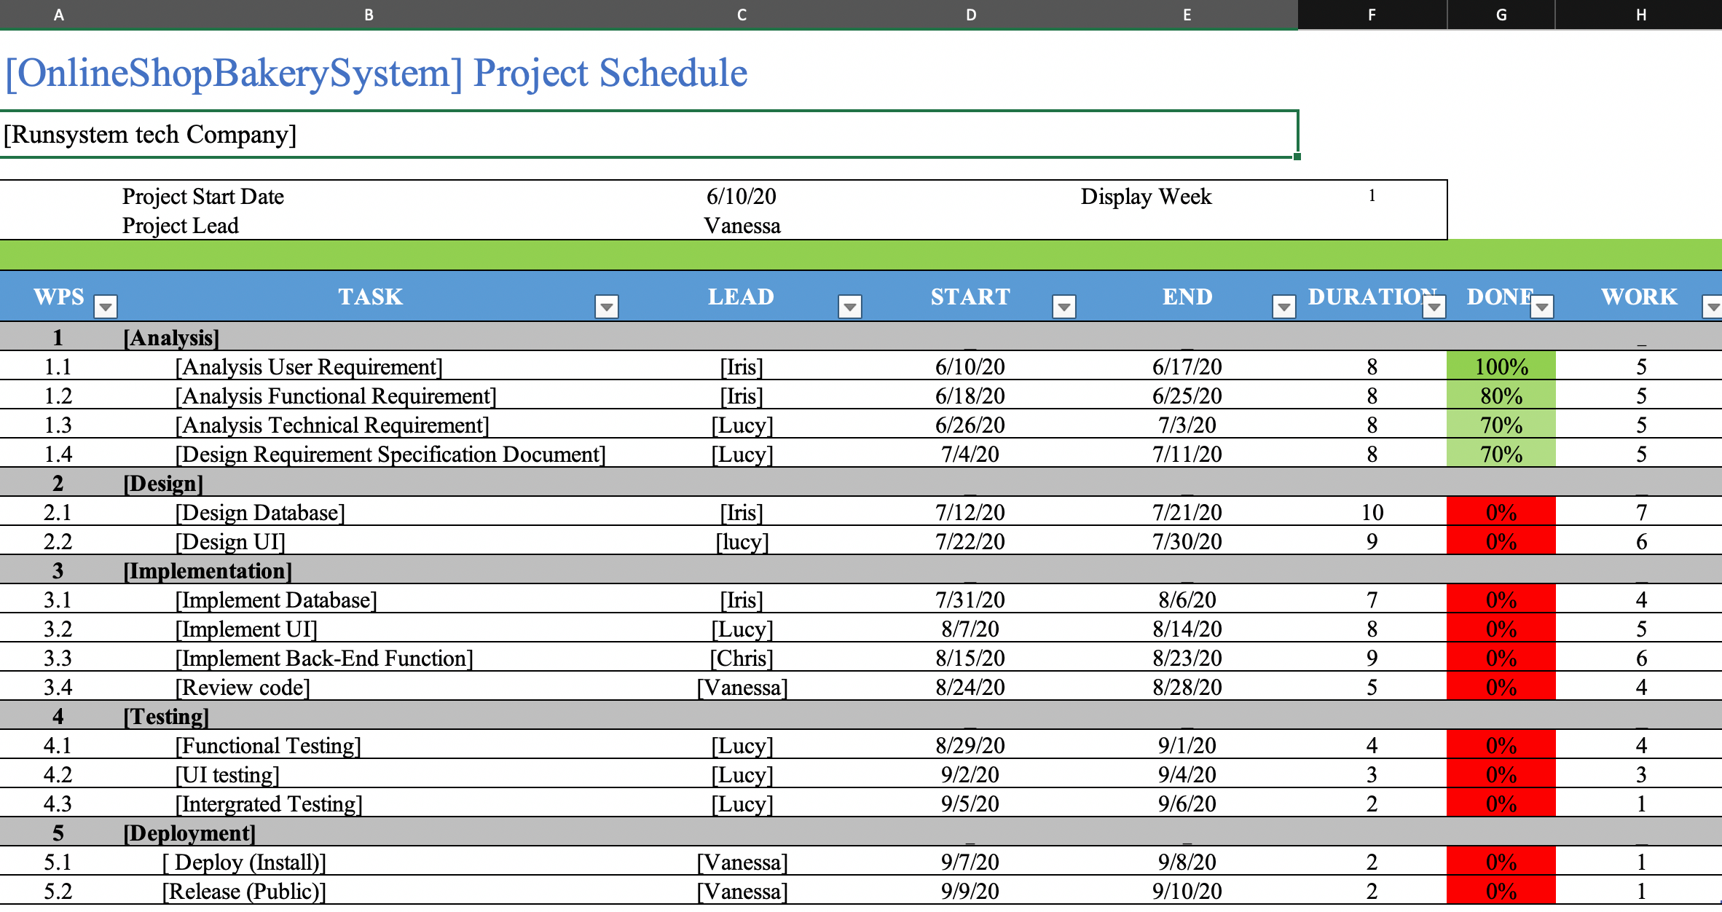
XI. GANTT CHART
Bakery Shop

Slide 42
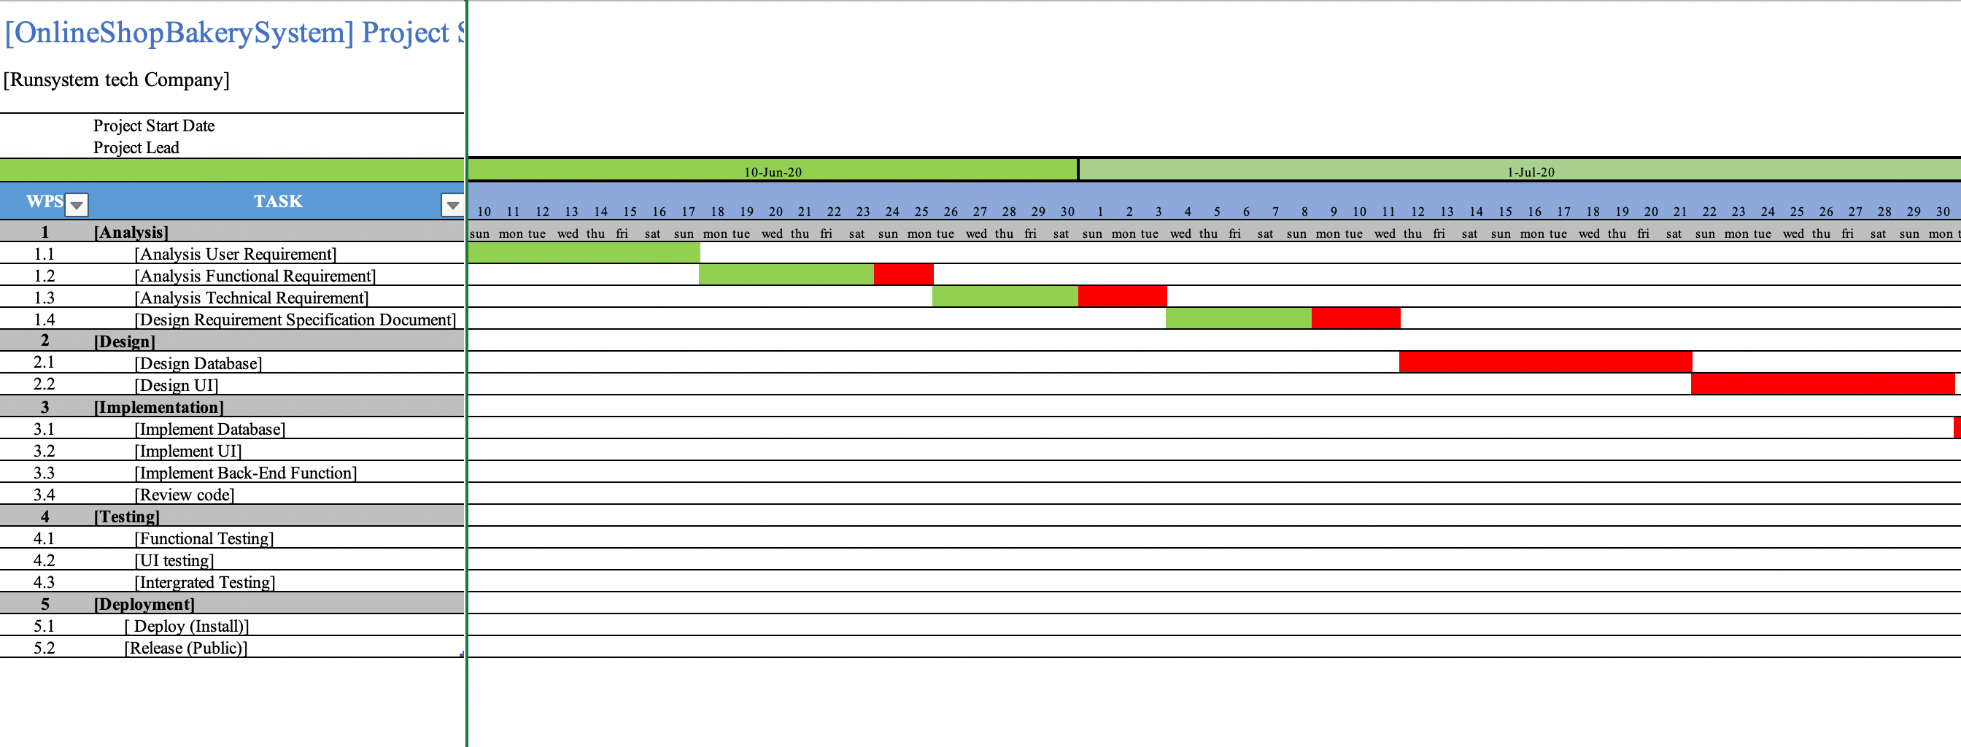
XI. GANTT CHART (cont.)
Bakery Shop

Slide 43
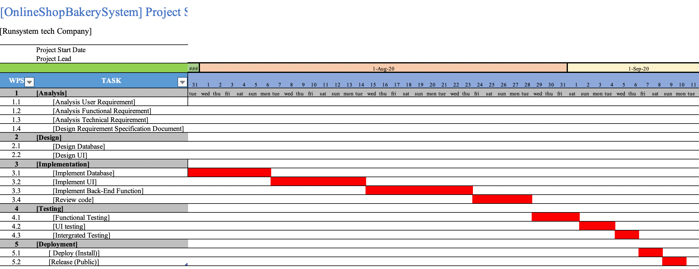
XI. GANTT CHART (cont.)
Bakery Shop

Slide 44
XII. COMMUNICATION PLAN WITH STAKEHOLDERS
Stakeholder | Document | Format | Purpose | Team Contact | Date Due
Customer | Gathering information document | Google form | Provide the required information | Chris | As needed
Owner | Gathering information document | Face – to – face | Provide the required information | Vanessa | Monthly / As needed
Staff | Gathering information document | Staff meeting | Provide the required information | Iris | As needed
Manager | Gathering information document | Interview | Provide the required information | Lucy | As needed
Business Analyst | Project Status Report | Hard Copy / Project Intranet | Report requirement collection results | Iris | Weekly
Developer | Project Status Report | Email/ Share drive | Progress report | Lucy & Chris | Daily
System analyst | Project Status Report | Email/ Share drive | Progress report | Vanessa | Daily
Tester | Project Status Report | Email/ Share drive | Progress report | Lucy | Daily
Project Manager | Project Status Report | Email/ Share drive/ Conference Call | Summary of project status | Vanessa | Daily/ Weekly
Designer | Project Status Report | Email/ Share drive | Progress report | Iris+ Vanessa | Daily
Bakery Shop

Slide 45
XIII. Appendix: User requirement
Interview Outline
Interviewee: Customers | Interviewer: Staffs
Location/Medium: 254 Nguyen Van Linh st., Danang city Phone number: 090567890 | Appointment Date: 30th May, 2020 Start Time: 6:00 a.m. End Time: 22:00 p.m.
Objectives: Collect data to design the online Bakery System What areas to explore: Business | Reminders: Interviewees are potential customers for the bakery Interviewees' opinions are based on actual surveys
General Observations: Interviewees are often those who want to enjoy bakery products or random guests. They have time for surveys and short interviews.
Interviewee: Customers | Date: 1st June, 2020
Questions | Notes:
When to ask question, if conditional Question: 1 How often do you go to the bakery shop? (MCs) | Answer Everyday: 36.4% Three times per week: 45.4% No: 18.2%
Question: 2 What is the favorite cake that you like in the bakery shop? | Answer Bread Chocolate involve Coffee cake, beer cake Donut, Cupcake Pudding cake Sweets cake bread cookie cupcakes
Bakery Shop

Slide 46
XIII. Appendix: User requirement (cont.)
Interview Outline
Question: 3 Have you ever ordered online the item in the bakery shop? | Answer Yes: 68.2% No: 31.8%
Question: 4 Do you want the application support to orders? | Answer Yes: 95.5% No: 4.5%
Question: 5 Do you want to confirm the orders before payment? | Answer Yes: 86.4% No: 13.6%
Question: 6 Which type of payment would you like to choose? | Answer Cash: 50% Credit card: 50%
Question: 7 What do you want the application to have? | Answer View E-menu: 72.7% View suggest item: 100%
Question: 8 Do you want to use the application on website? | Answer Yes: 81.8% No: 18.2%
Question: 9 What do you want to register by? | Answer Form: 90.9% Face: 54.5%
Question: 10 Do you want an application to suggest a bakery for you? | Answer Yes: 95.5% No: 4.5%
Question: 11 What do you want to have an introduction to using the system? | Answer Introduction by text: 86.4% Introduction by voice: 13.6%
Question: 12 How do you want to receive a confirmation message by? | Answer Email: 59.1% Phone: 40.9%
Bakery Shop

Slide 47
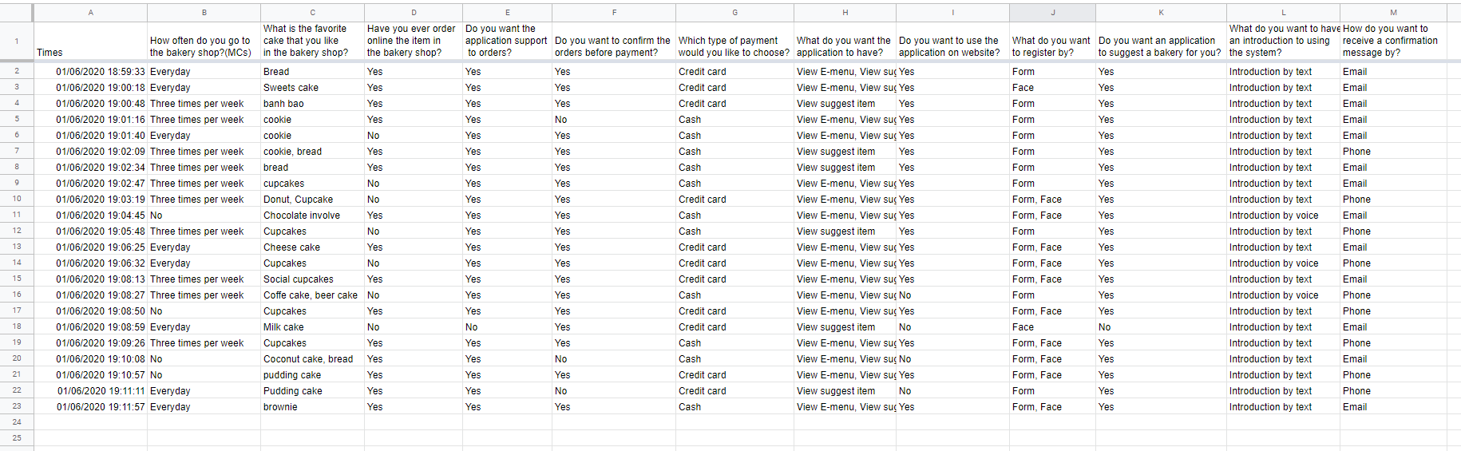
Bakery Shop
shorturl.at/cloyO

Slide 48
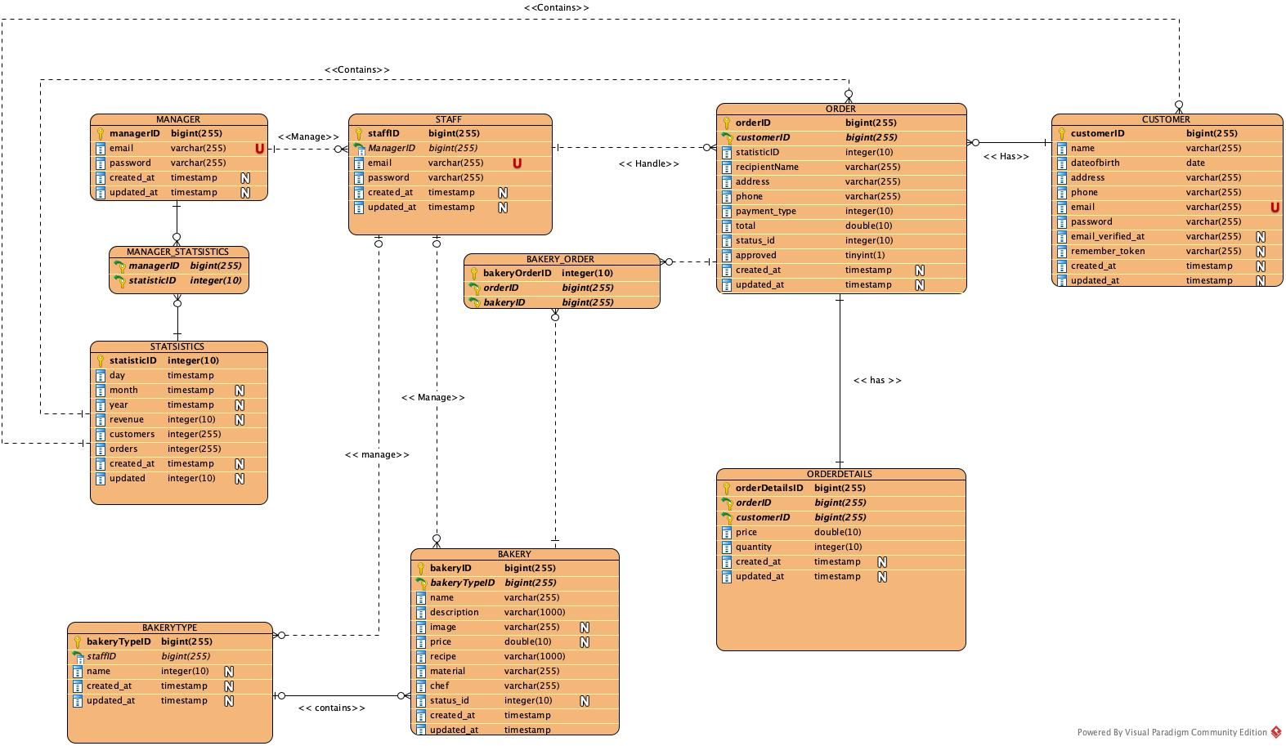
XIV. E-R diagram
Bakery Shop

Slide 49

XV. GUI of the proposed system
Account
Bakery products
Orders
Statistics
Manage staff
Bakery Shop
http://goldenrestaurant.herokuapp.com/

Slide 50


THANK YOU FOR YOUR ATTENTION
Bakery Shop

